Slide 2
Intro to Git
Alexander Stevenson
Software Engineer at Cisco Systems Twitter handle: @alexstev_dev
DEVWKS-1255

Slide 3

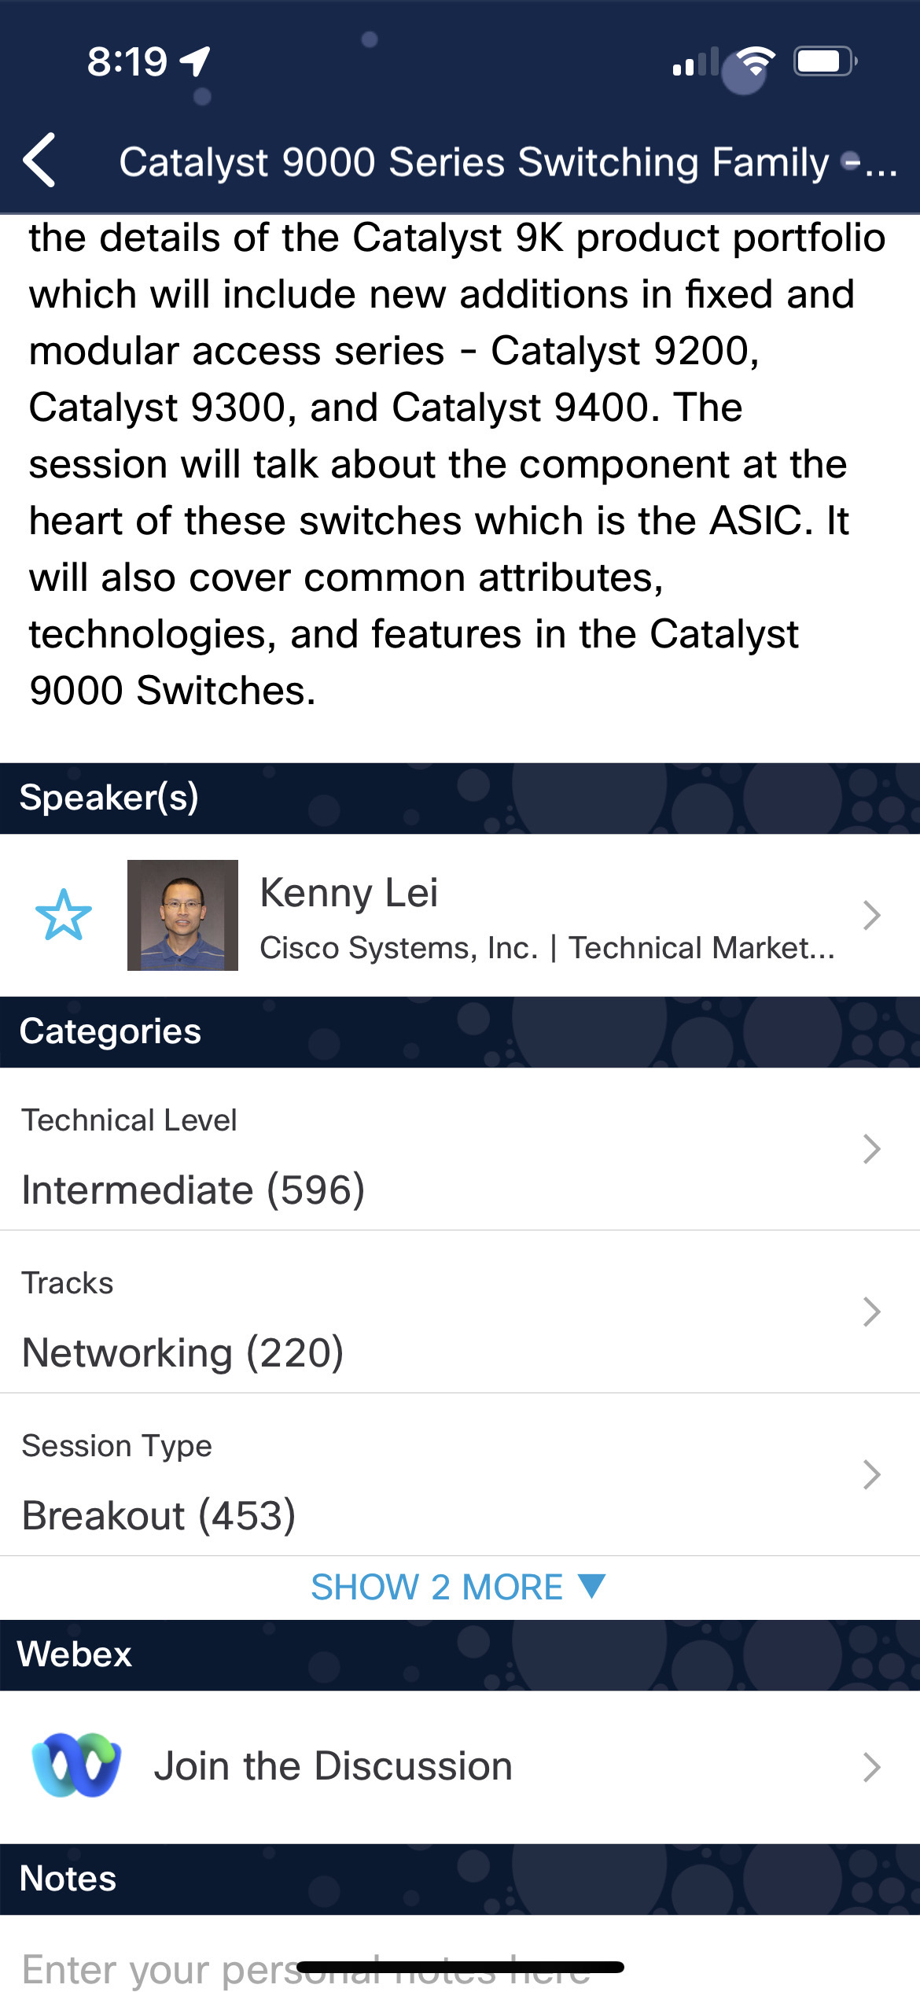
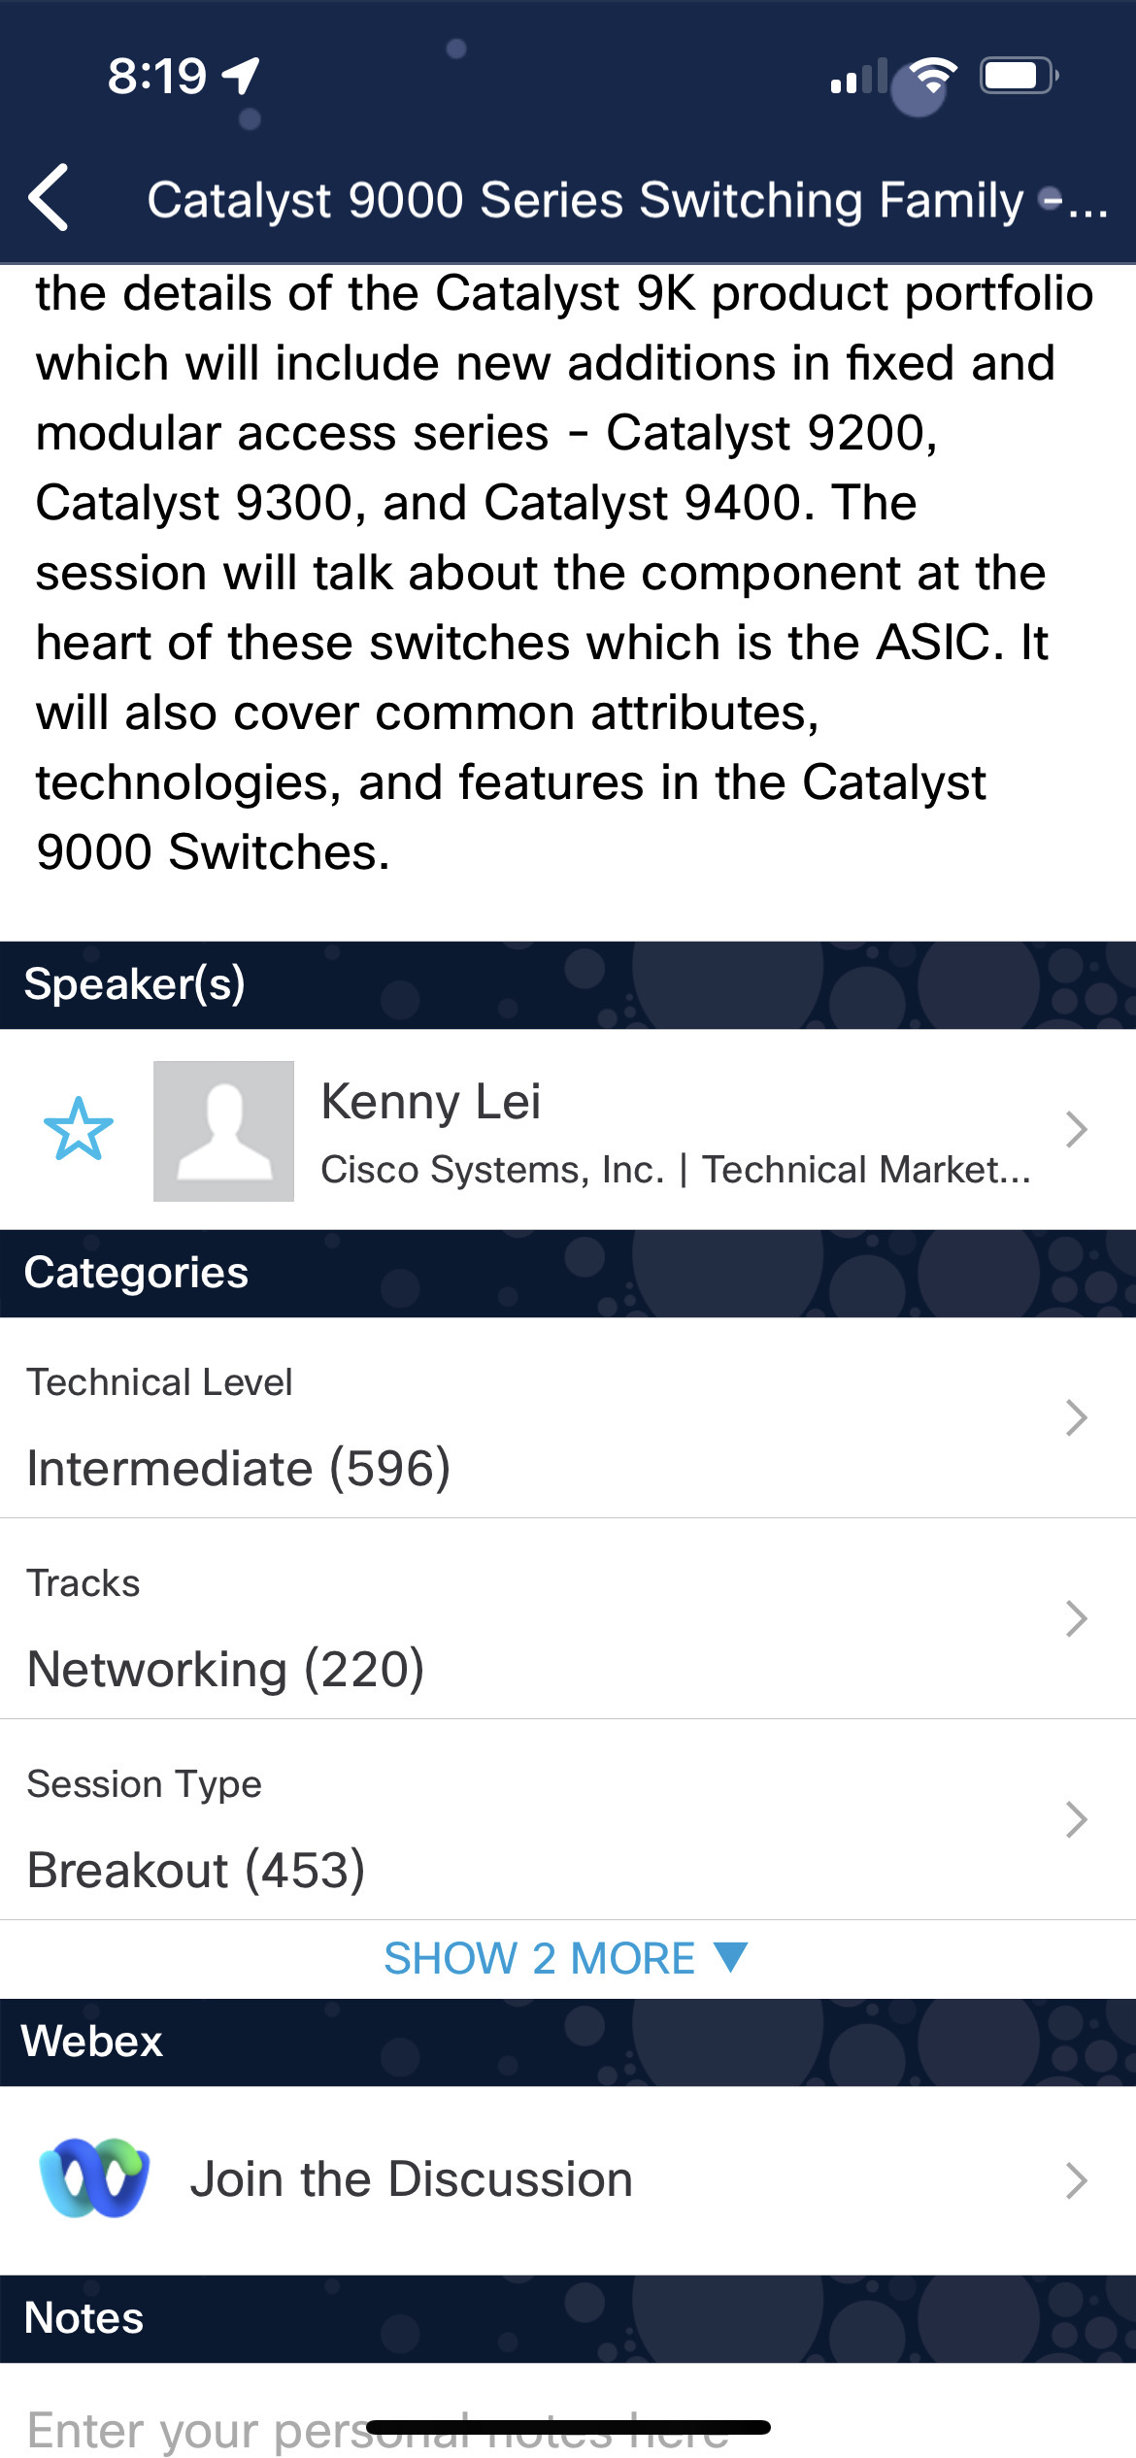

Cisco Webex App
Questions? Use Cisco Webex App to chat with the speaker after the session
How
1
Find this session in the Cisco Live Mobile App
Click “Join the Discussion”
Install the Webex App or go directly to the Webex space
Enter messages/questions in the Webex space
2
3
Enter your personal notes here
4
Webex spaces will be moderated by the speaker until June 9, 2023.
https://ciscolive.ciscoevents.com/ciscolivebot/#BRKXXX-xxxx
© 2023 Cisco and/or its affiliates. All rights reserved. Cisco Public
3

Slide 4
A Brief Introduction to Git
https://developer.cisco.com/learning/modules/programming-fundamentals/dne-git-basic-workflows/hands-on-with-git-and-github/

Slide 5
Introduction
What is Git?
Getting familiar with the Cisco DevNet Learning Lab environment
Hands-on lab
Call to Action

Slide 6
Introduction

Slide 7
A UNIX programmer was working in the cubicle farms. As she saw the Git Guru traveling down the path, she ran to meet them. "It is an honor to meet you, Git Guru!" she said. "I have been studying the UNIX way of designing programs that each do one thing well. Surely I can learn much from you." "Surely," replied the Git Guru.

Slide 8
"How should I change to a different branch?" asked the programmer. "Use git checkout." "And how should I create a branch?" "Use git checkout." "And how should I update the contents of a single file in my working directory, without involving branches at all?" "Use git checkout." After this third answer, the programmer was enlightened.
from Git Koans
by Steve Losh

Slide 9
What is Git?

Slide 10
Git
Git manages files on your computer so that when you make changes, you can compare old and new versions of files. This aspect of file management is called Version Control.
GitHub also enables you to coordinate work with others on new versions of files.

Slide 11
Git
Objectives
Understand what problems Version Control Systems help us solve.
Learn and practice your first Git workflows.
Clone our sample code in the browser development environment.
Create a "safe place" for you to make and commit your changes.
Learn how to incrementally save your code changes.

Slide 12
Getting familiar with the Cisco DevNet Learning Lab environment

Slide 13

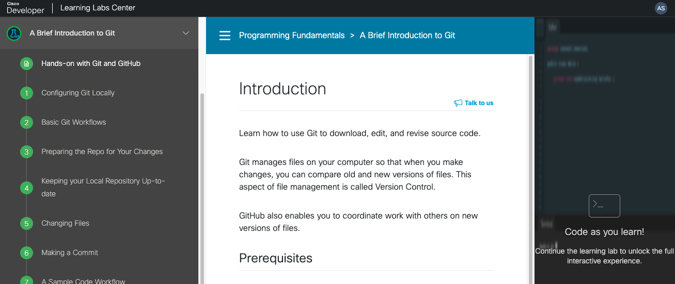
Table of Contents Instructions Code IDE
Main parts of Learning Lab environment
#CiscoLive
© 2022 Cisco and/or its affiliates. All rights reserved. Cisco Public

Slide 14
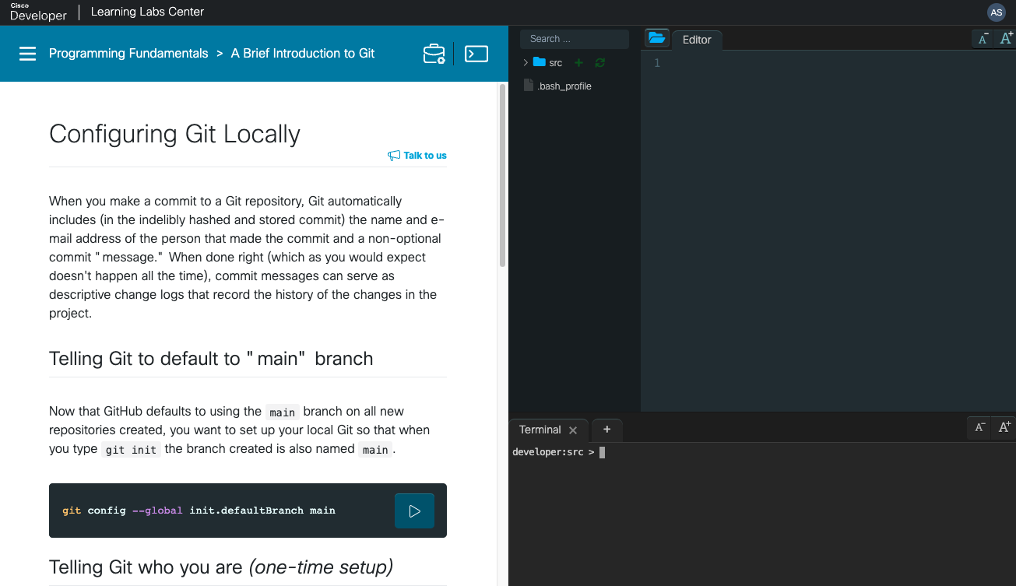
Lab walk-through File System and Editor Interactive terminal
#CiscoLive
© 2022 Cisco and/or its affiliates. All rights reserved. Cisco Public

Slide 15
Hands-on lab

Slide 16
A Brief Introduction to Git https://developer.cisco.com/learning/modules/programming-fundamentals/dne-git-basic-workflows/hands-on-with-git-and-github/

Slide 17
Call to Action

Slide 18
Call to action Git-related Learning Labs
1
2
3
Introduction to Version Control Systems
Learn how to use Git for version control including configuration, commits, and differences.
Git Branching
Learn the basics of Git branching so that you can diverge from the main code base.
Using Git with servers
Learn how to use Git with servers to share your work with others.

Slide 19
Our new Learning Labs
29 Learning Tracks
116 Learning Modules
451 Learning Labs

Slide 20



Fill out your session surveys!
Attendees who fill out a minimum of four session surveys and the overall event survey will get Cisco Live-branded socks (while supplies last)!
Attendees will also earn 100 points in the Cisco Live Game for every survey completed.
These points help you get on the leaderboard and increase your chances of winning daily and grand prizes

Slide 21

Continue your education
Visit the Cisco Showcase for related demos
Book your one-on-one Meet the Engineer meeting
Attend the interactive education with DevNet, Capture the Flag, and Walk-in Labs
Visit the On-Demand Library for more sessions at www.CiscoLive.com/on-demand

